Slide 1
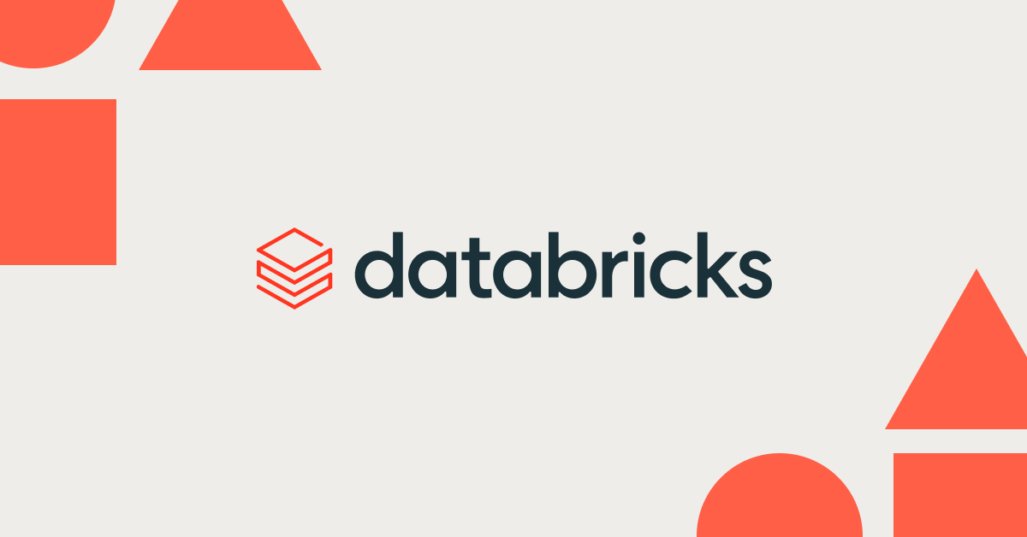
Search and Ranking Algos in RAG

Slide 2
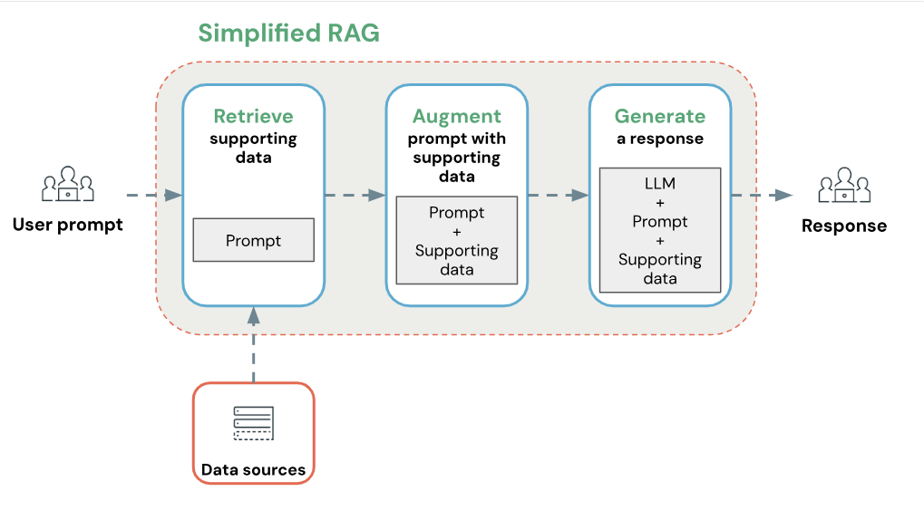
Why and Where does it all boil down to?
If your search and ranking algorithms are broken, your retrieval pipeline breaks down and results in a catastrophe for your RAG application

Slide 3
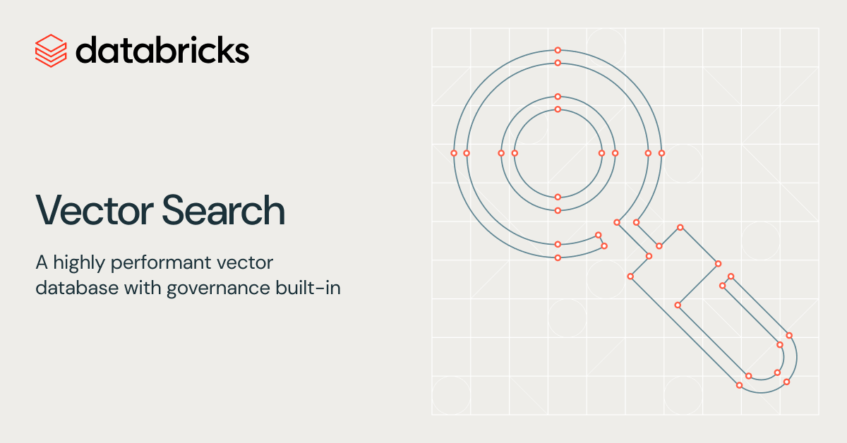
How does Mosaic AI Vector Search Work?
Vector Search Basics
Uses embeddings to find similar data
Powered by the HNSW algorithm
Fast and scalable approximate search
Uses L2 distance to measure similarity
Cosine Similarity (Important Note)
Vector Search uses L2 distance by default
If you want cosine similarity:
Normalize embeddings before indexing
After normalization:
L2 distance ≈ cosine similarity
Hybrid Search (Vector + Keywords)
Combines:
Vector-based semantic search
Keyword-based exact matching
Matches:
Meaning of the query
Exact words in the query

Slide 4
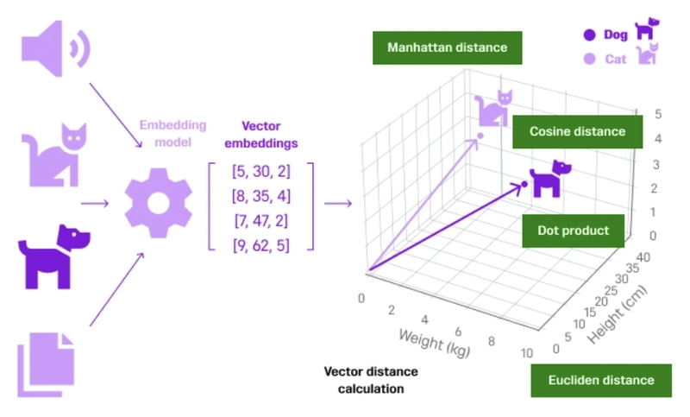
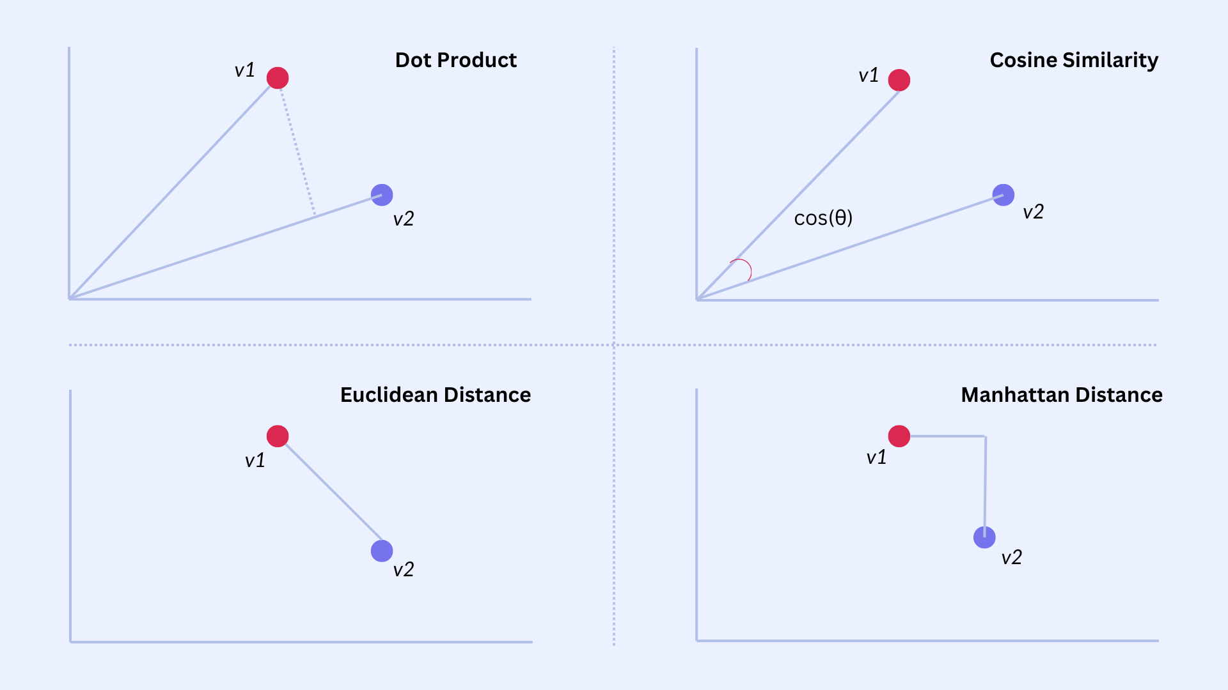
What does it mean to find similar vectors?
What Does It Mean to Find Similar Vectors?
Data (text, images, audio) is converted into vectors (numbers)
Each vector represents the meaning of the data
Finding similar vectors means:
Finding data with similar meaning
How Similarity Is Measured
Vectors are treated as points in space
Distance between points = similarity
Closer vectors → more similar
Farther vectors → less similar
Now you basically need two things: 1) A high dimensional space for arranging your vectors.
2) A mathematical model to compute similarity scores between vectors

Slide 5
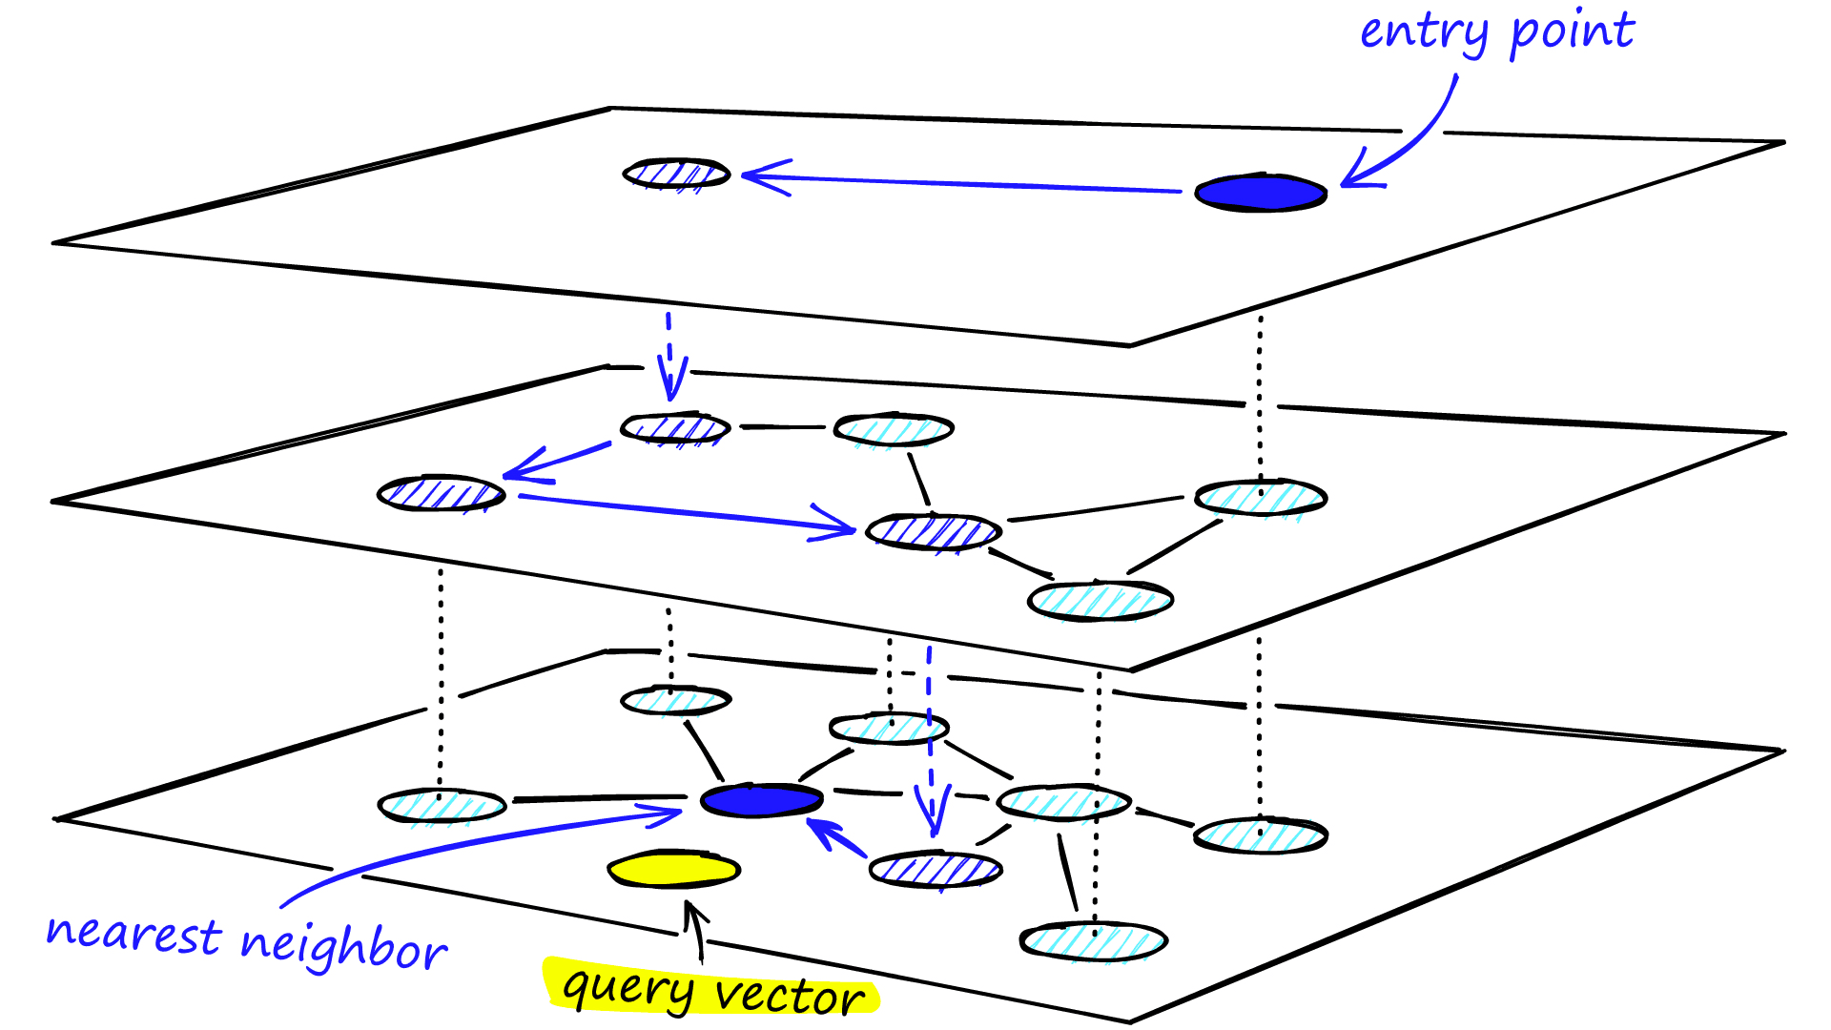
What is a HSNW Arrangement of Vectors ?
HNSW indexes use a hierarchical layering of data. Imagine multiple layers of graphs stacked on top of each other. The top layer is the most sparse, and each layer gets more dense with nodes until we get to the bottom layer. If a node is on a given layer, the same node is also in the layer below it.
If we did a brute-force approach to find the top k closest neighbours for a given vector, we would have to do this search in O(N) time, as we need to compute the pairwise distance between the query vector and every other vector.
HNSW lets us compute and find the top k closest neighbours for a given vector in O(logN) time!

Slide 6
Vector Search/Semantic Search
Vector Search
What it means
A way to search data using embeddings
Finds vectors that are closest to a query vector
How it works
Data is converted into embeddings
Query is also converted into an embedding
System retrieves the most similar vectors
Similarity inside vector search
Uses distance metrics like:
L2 (Euclidean distance)
Cosine similarity (conceptually)
Databricks detail
Databricks uses L2 distance
If embeddings are normalized:
L2 distance behaves the same as cosine similarity
When to use
Semantic search
RAG pipelines
Recommendations
Key idea
Vector search finds content with similar meaning, not exact words.

Slide 7
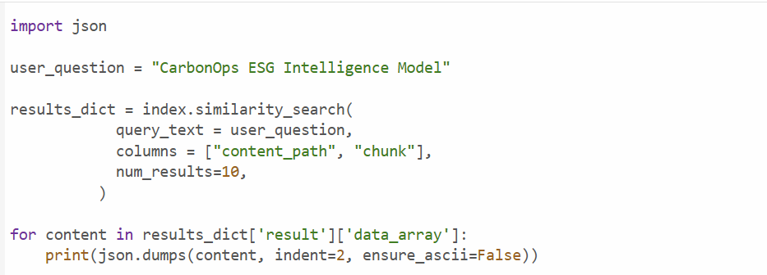

Slide 8
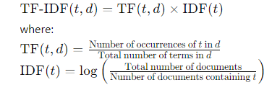
Keyword Search
What Is Keyword Search?
Searches for exact words in documents
Matches text based on:
Terms
Tokens
Phrases
Does not understand meaning
How Keyword Search Works
Breaks text into words (tokens)
Finds documents containing the same words as the query
Uses scoring methods like:
Term frequency
Exact match ranking
When to Use Keyword Search
Searching logs, tickets, catalogs
Queries with exact terms
Structured or identifier-based data
One-line takeaway :
Keyword search finds exact words, not meaning.

Slide 9
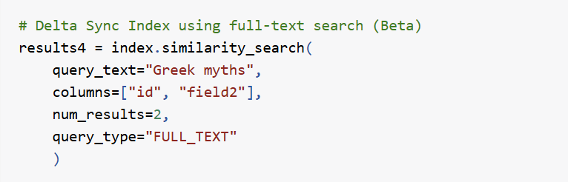

Slide 10
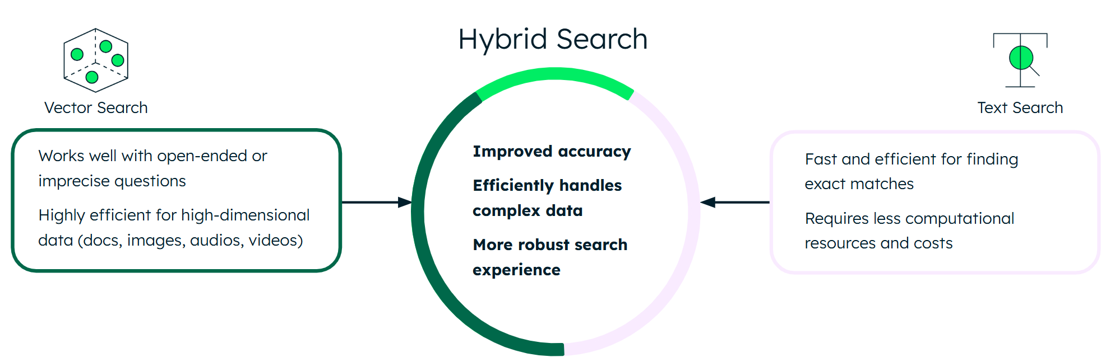
Hybrid Search
What Is Hybrid Search?
Combines:
Vector search (semantic meaning)
Keyword search (exact matches)
Uses both signals together
Why Hybrid Search Is Needed
Some terms:
IDs
SKUs
Codes
Names
Do not embed well semantically
Keyword search handles these better
When to Use Hybrid Search
RAG with structured identifiers
Enterprise data (products, tickets, logs)
When accuracy matters for both:
Meaning
Exact terms
One-line takeaway:
Hybrid search gives the best of both worlds: meaning + exact match.

Slide 11
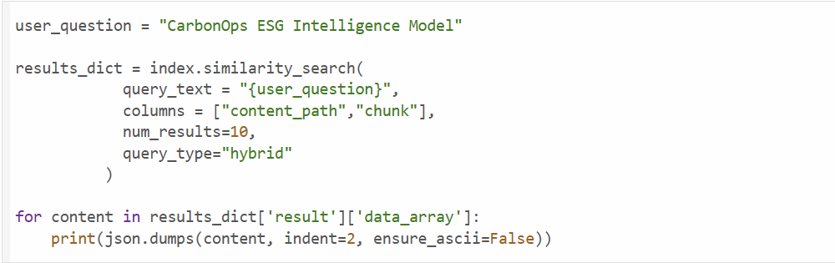

Slide 12
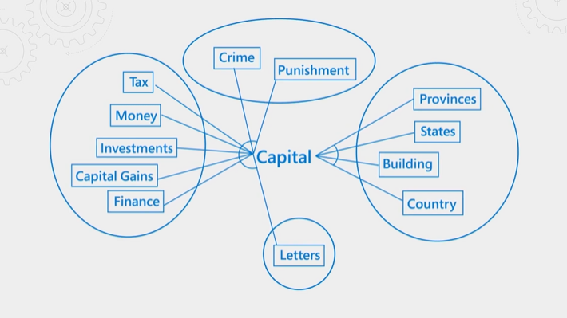
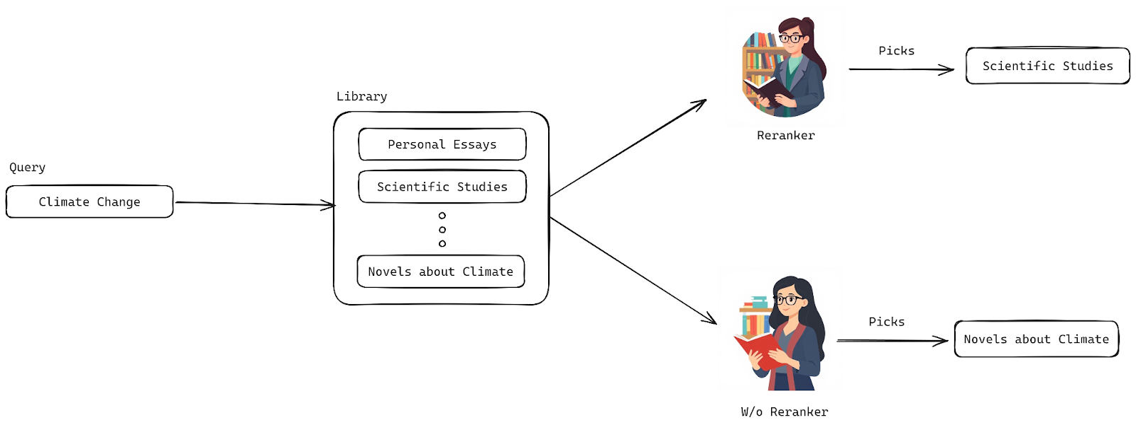
Semantic Re-Ranking in Databricks
Semantic Re-Ranking (Databricks)
What Is Semantic Re-Ranking?
A second pass that improves search results
Re-orders retrieved documents based on deep semantic relevance
Happens after keyword search or vector search
How It Works (Conceptually)
Initial search retrieves candidate results
Keyword search
Vector (semantic) search
A stronger model (often an LLM or cross-encoder):
Re-evaluates query + document together
Results are re-ranked by true relevance
Why Re-Ranking Is Needed
Initial search is optimized for speed
Top results may still include:
Partially relevant documents
Keyword-heavy but less meaningful matches
Re-ranking improves precision at the top

Slide 13
